Slide 1
BEE : Bureau of Energy Efficiency
The Government of India set up Bureau of Energy Efficiency (BEE). on 1st March 2002 under the provisions of the Energy Conservation Act, 2001.
‹#›

Slide 2
Mission of BEE
The mission of the Bureau of Energy Efficiency is to assist in developing policies and strategies with a thrust on self-regulation and market principles, within the overall framework of the Energy Conservation Act, 2001 with the primary objective of reducing energy intensity of the Indian economy.
‹#›

Slide 3
Role of BEE
BEE co-ordinates with designated consumers, designated agencies and other organizations and recognize, identify and utilize the existing resources and infrastructure, in performing the functions assigned to it under the Energy Conservation Act. The Energy Conservation Act provides for regulatory and promotional functions.
‹#›
Notes:
‹#›

Slide 4
The Major Promotional Functions of BEE include:
1 | Create awareness and disseminate information on energy efficiency and conservation
2 | Arrange and organize training of personnel and specialists in the techniques for efficient use of energy and its conservation
3 | Strengthen consultancy services in the field of energy conservation
4 | Promote research and development
5 | Develop testing and certification procedures and promote testing facilities
‹#›
Notes:
The Major Promotional Functions of BEE include:
‹#›

Slide 5
6 | Formulate and facilitate implementation of pilot projects and demonstration projects
7 | Promote use of energy efficient processes, equipment, devices and systems
8 | Take steps to encourage preferential treatment for use of energy efficient equipment or appliances
9 | Promote innovative financing of energy efficiency projects
11 | Prepare educational curriculum on efficient use of energy and its conservation
12 | Implement international co-operation programmes relating to efficient use of energy and its conservation
‹#›

Slide 6
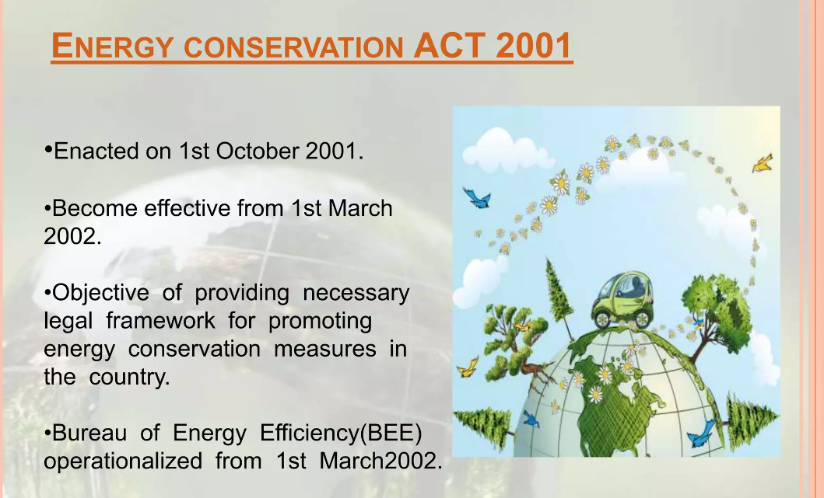
‹#›

Slide 7
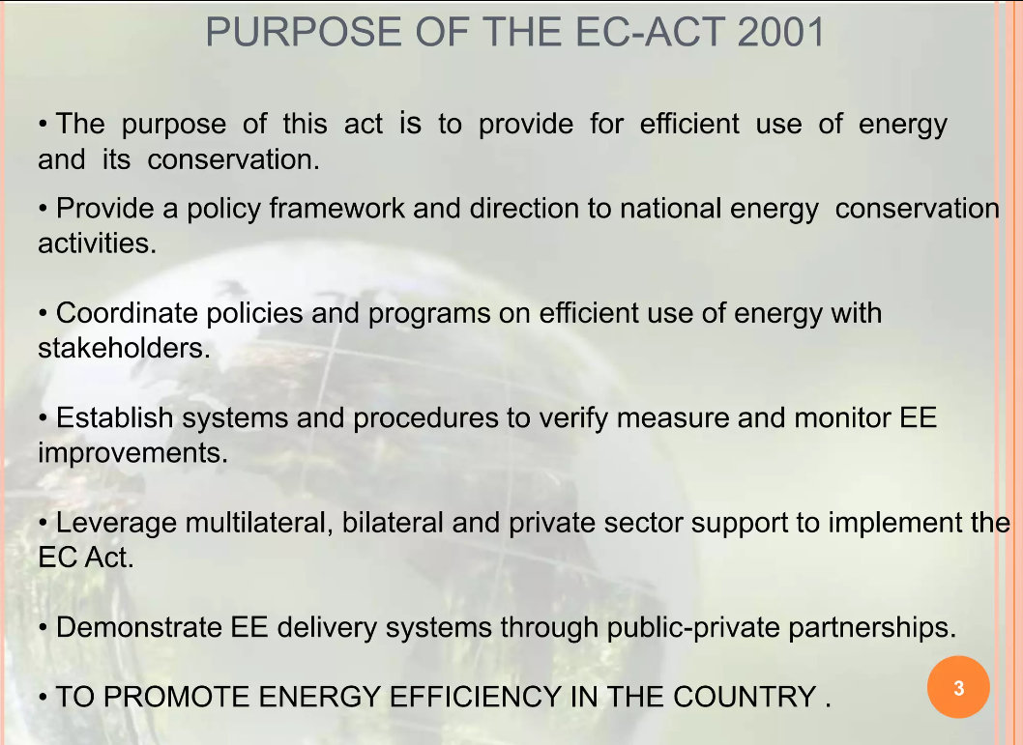
‹#›

Slide 8
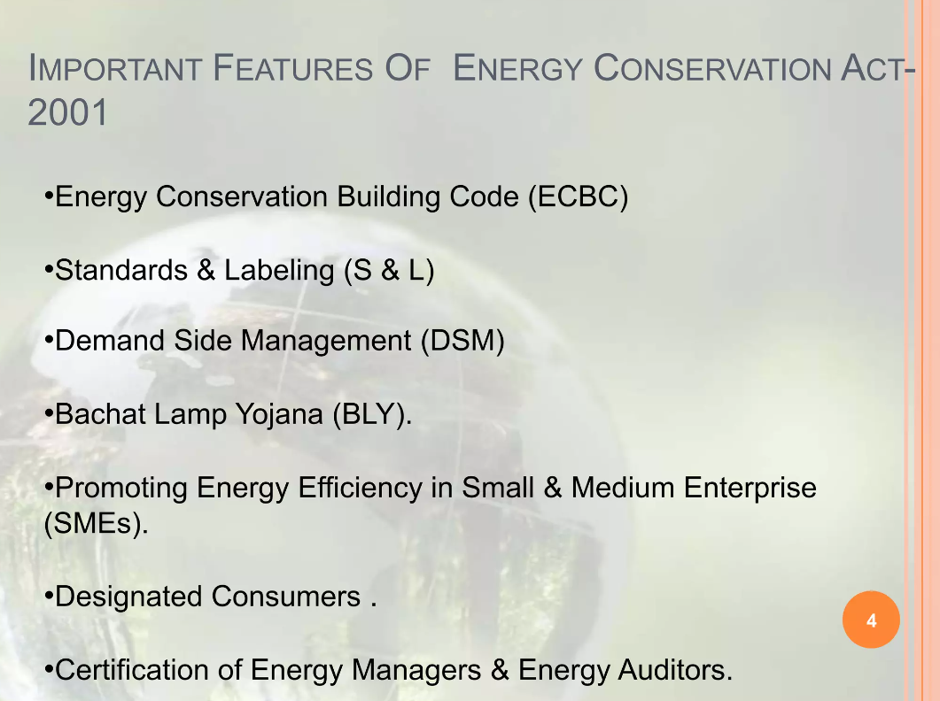
‹#›

Slide 9
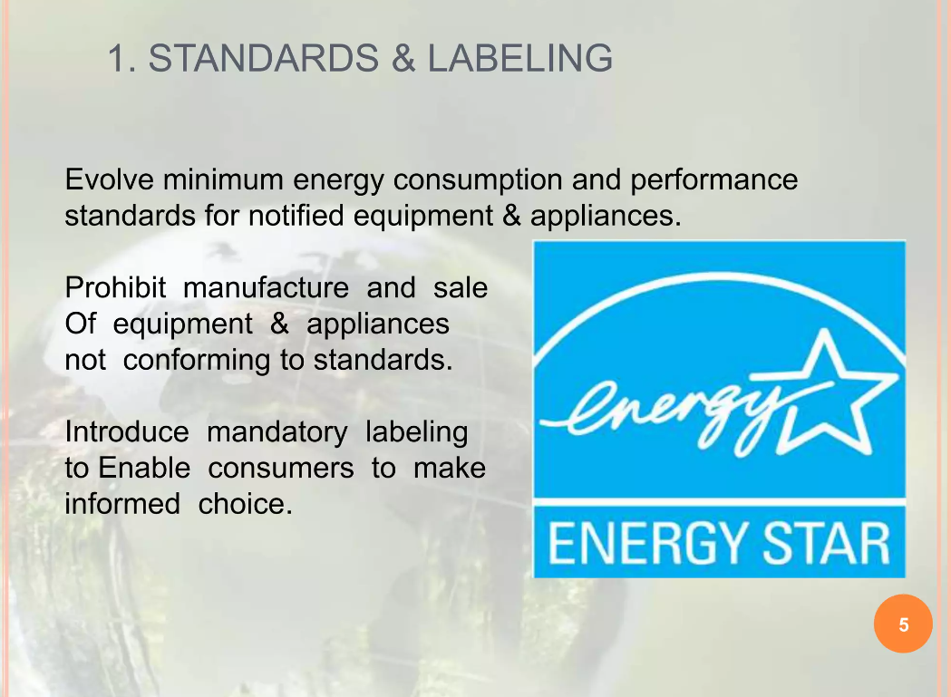
‹#›

Slide 10
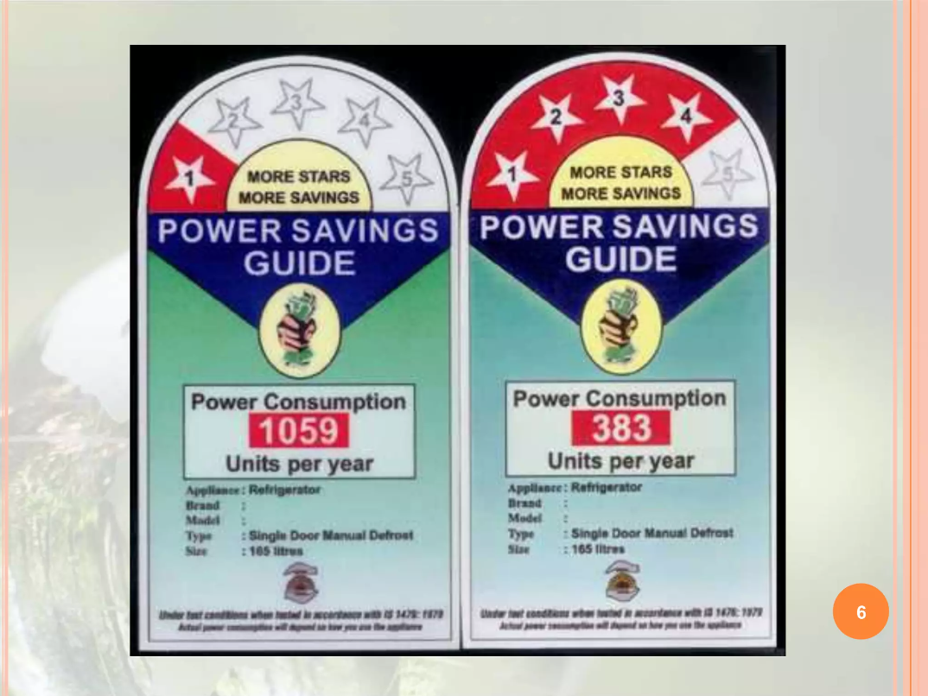
‹#›

Slide 11
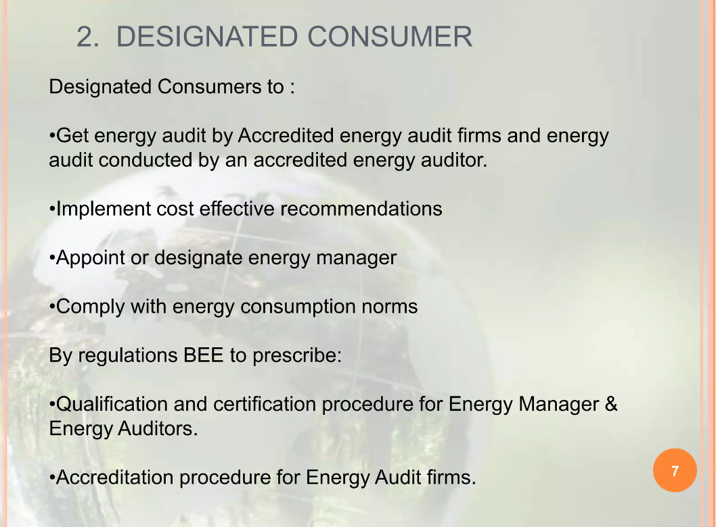
‹#›

Slide 12
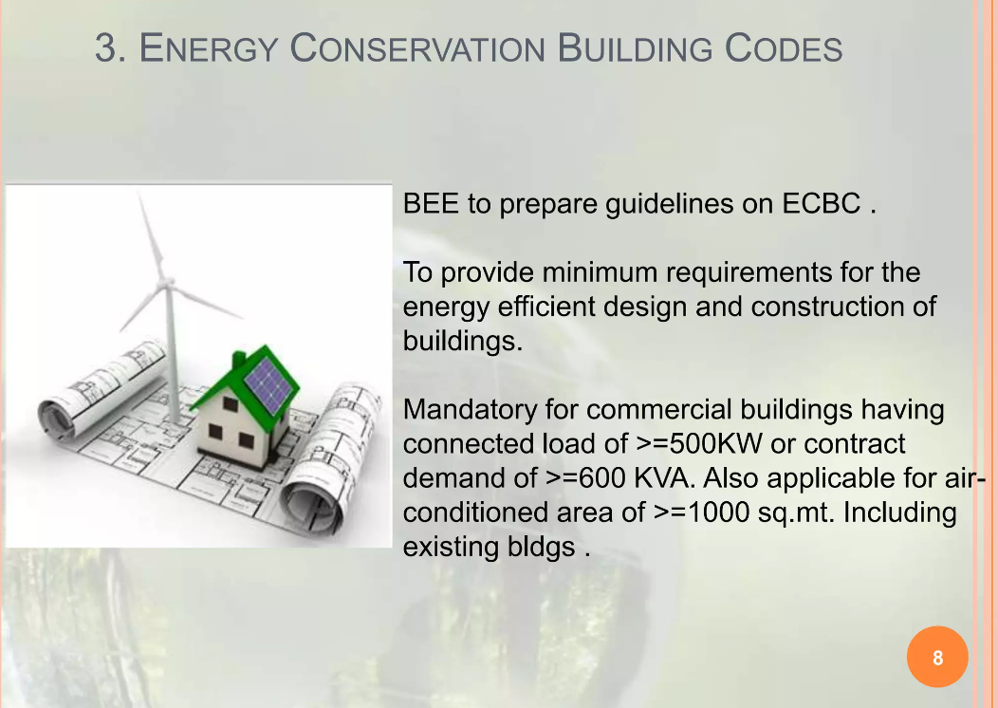
‹#›

Slide 13
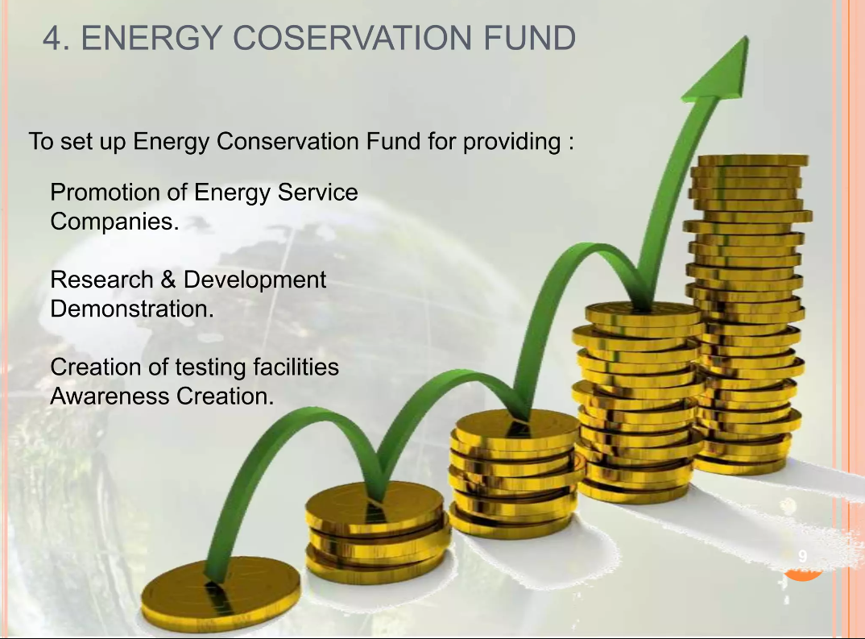
‹#›

Slide 14
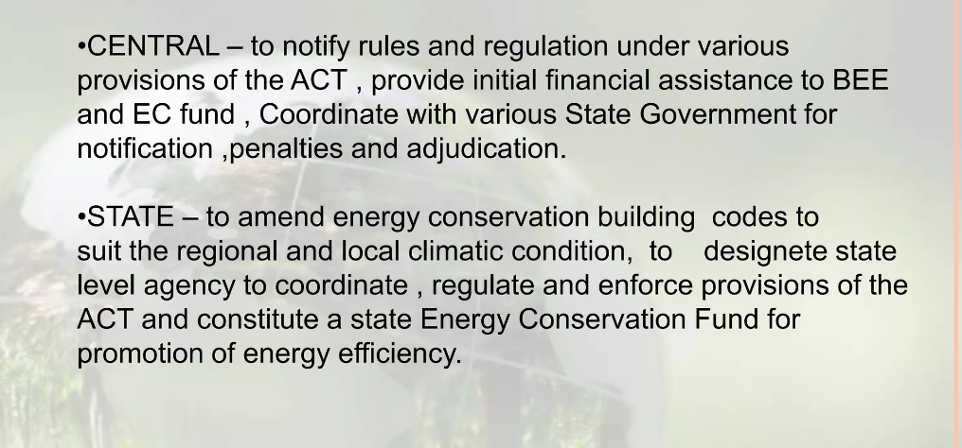
Role of central and state government
‹#›

Slide 15
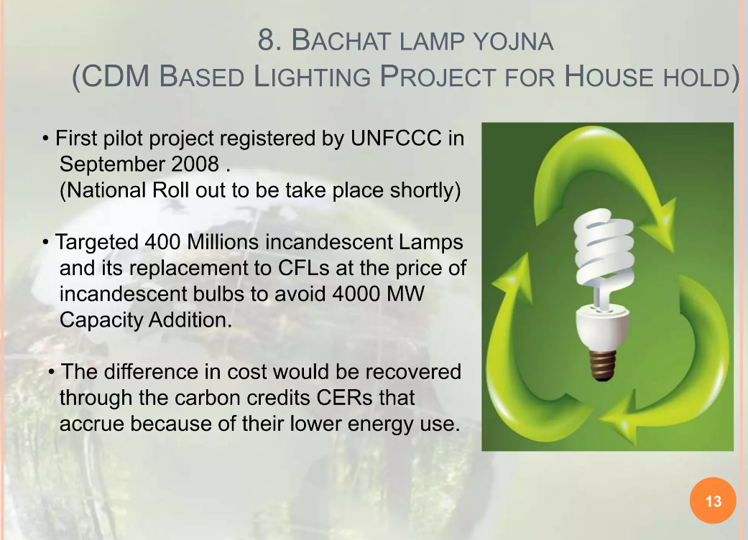
‹#›

Slide 16
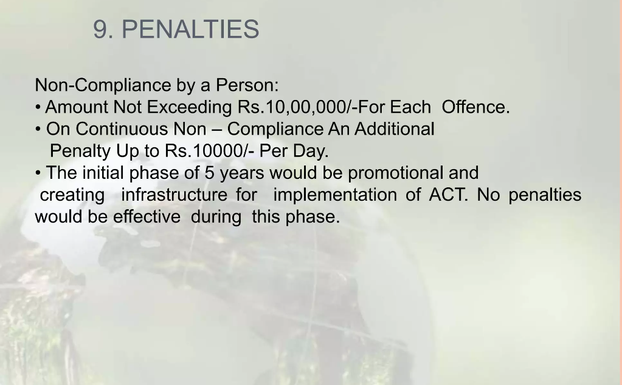
‹#›

Slide 17
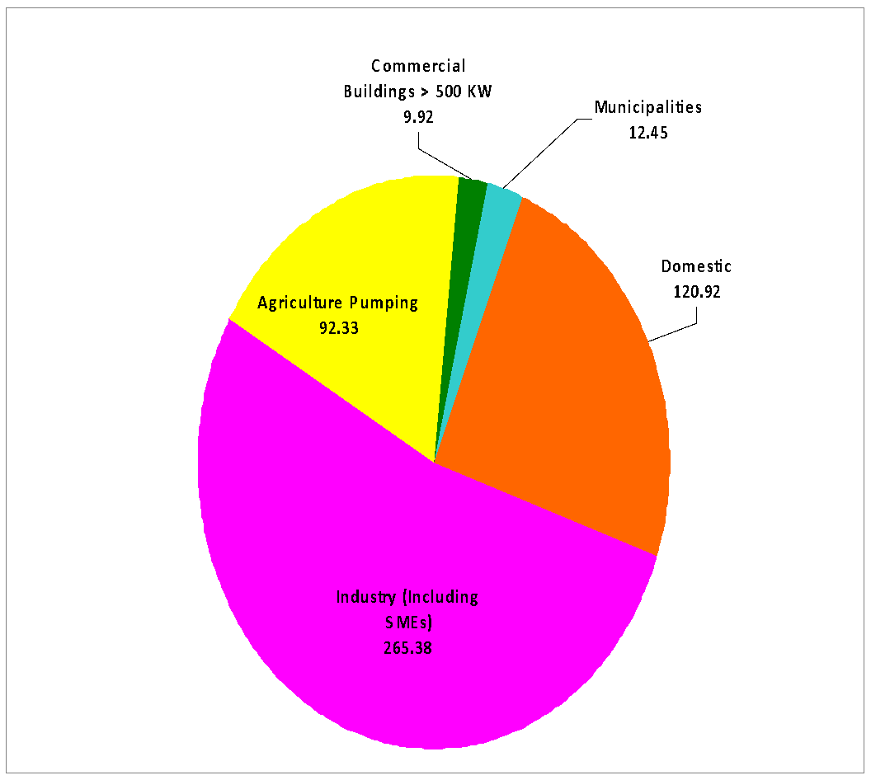
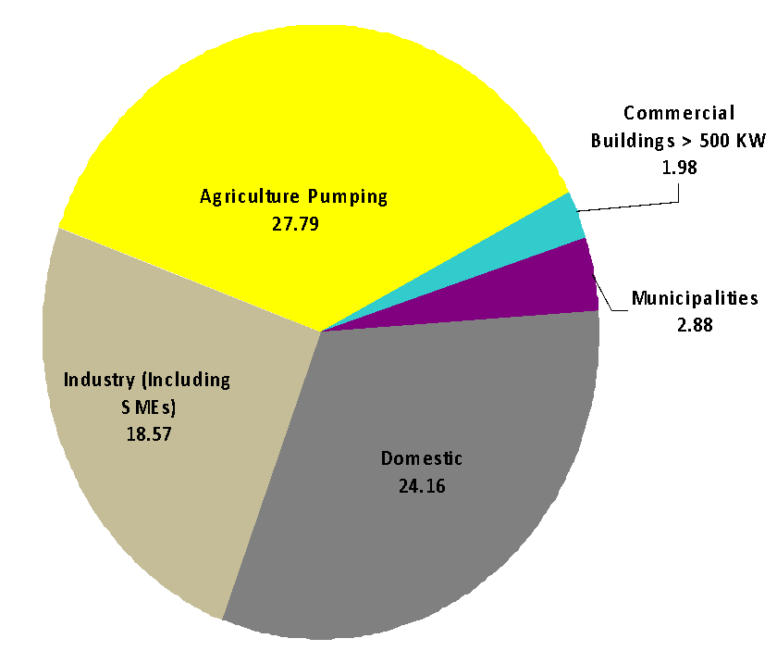
Electrical Energy Consumption and Conservation Potential
S. No. | Sector | Consumption (KWh) | Saving Potential (KWh) | % Savings
1. | Agriculture Pumping | 92.33 | 27.79 | 30.09
2. | Commercial Buildings/ Establishments with connected load > 500 KW | 9.92 | 1.98 | 19.95
3. | Municipalities | 12.45 | 2.88 | 23.13
4. | Domestic | 120.92 | 24.16 | 19.98
5. | Industry (Including SMEs) | 265.38 | 18.57 | 6.99
 | Total | 501.00 | 75.36 | 15.04
‹#›
Source: BEE/ NPC Study 2009
Notes:
‹#›

Slide 18
Energy Efficiency – Action Plan
Bachat Lamp Yojana to promote energy efficient and high quality CFLs as replacement for incandescent bulbs in households.
Standards & Labeling Scheme targets high energy end use equipment and appliances to lay down minimum energy performance standards.
Energy Conservation Building Code (ECBC) sets minimum energy performance standards for new commercial buildings.
Agricultural and Municipal DSM targeting replacement of inefficient pumpsets, street lighting, etc.
Operationalising EC Act by Strengthening Institutional Capacity of State Designated Agencies (SDAs) : The scheme seeks to build institutional capacity of the newly created SDAs to perform their regulatory, enforcement and facilitative functions in the respective States.
Energy Efficiency Improvement in Small and Medium Enterprises (SMEs): To stimulate energy efficiency measures in 25 high energy consuming small and medium enterprise clusters.
‹#›
Notes:
‹#›

Slide 19
Promoting Supply of Energy Efficiency Goods and Services
-Promotion of ESCOs – 35 ESCOs empanelled and rated through leading rating agencies of India (CRISIL/ ICRA)
-List of ESCOs being expanded to at least double this number
-Bi-annual National Examination for certification of Energy Management Professionals – 8 exams conducted and 8000 Energy Managers and Auditors certified
-10 equipment's covered under the Standards and Labeling programmed (ACs, Refrigerators, Tube lights, Distribution Transformers, Ceiling Fans, Pumps, Motors, Colour TVs, Geysers and LPG Stoves). Standards for first 4 equipment's to be mandatory by January, 2010.
-Training of energy efficiency professionals in all sectors like the states, buildings, appliances, SMEs, etc.
‹#›
Notes:
‹#›

Slide 20


Enabling Finance for Energy Efficiency Goods and Services
-Creation of Energy Efficiency Financing Platform (EEFP) to provide non-recourse financing to ESCO projects- 2 Financial Institutions have joined and commenced financing (PTC India Ltd and SIDBI)
-Provision of Partial Risk Guarantee Fund for provide partial guarantees to ESCO projects- part of NMEEE and World Bank and GEF providing Technical Assistance for setting it up
-Setting up of Venture Capital Fund to provide last mile equity to enable financial closure of ESCO projects – part of NMEEE
-Training modules for banks and financial institutions prepared and training initiated to enhance awareness about performance contracting and appraisals thereof.
- Tax incentives for ESCOs being proposed
‹#›
Notes:
‹#›

Slide 21
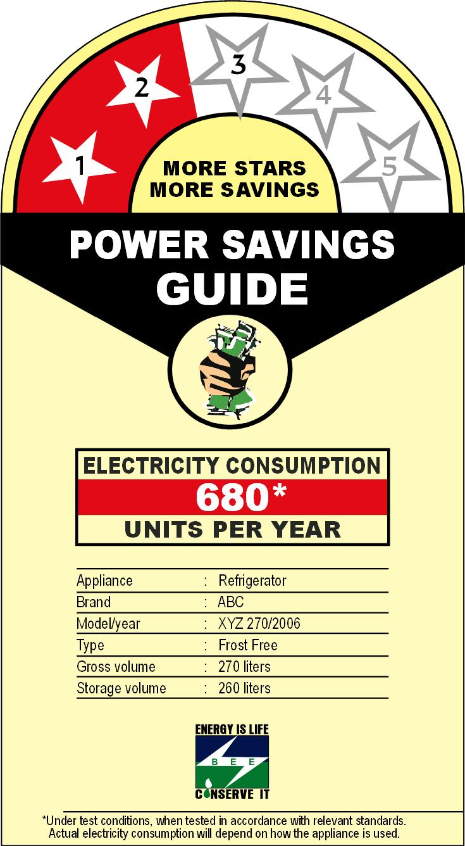

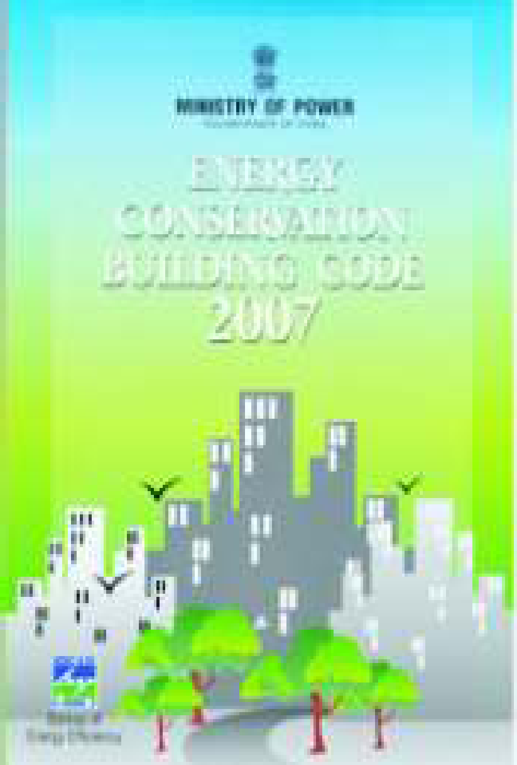
National Mission for Enhanced Energy Efficiency (NMEEE)
‹#›
Notes:
‹#›

Slide 22
NMEEE-4 New Initiatives
A market based mechanism to enhance cost effec­tiveness of improvements in energy efficiency in energy-intensive large industries and facilities, through certification of energy savings that could be traded. (Perform Achieve and Trade)
Accelerating the shift to energy efficient appliances in designated sectors through innovative measures to make the products more affordable. (Market Transformation for Energy Efficiency))
Creation of mechanisms that would help finance demand side management programmes in all sectors by capturing future energy savings. (Energy Efficiency Financing Platform (EEFP))
Developing fiscal instruments to promote energy efficiency namely Framework for Energy Efficient Economic Development (FEEED)
‹#›
Notes:
‹#›

Slide 23
Objectives of NMEEE
The basic tenet of the mission is to ensure a sustainable growth by an appropriate mix of 4 E’s namely- Energy, Efficiency, Equity and Environment.
Promote development objectives, while also yielding co-benefits for addressing climate change effects.
By 2014-15:
Annual fuel savings in excess of 23 million toe
Cumulative avoided electricity capacity addition of 19,000 MW
CO₂ emission mitigation of 98 million tons per year
Market based approach to implementation of energy efficiency – market size of USD 18 b to be unlocked
‹#›
Notes:
‹#›

Slide 24
Perform Achieve and Trade (PAT)
(a) Methodology for setting Specific Energy Consumption (SEC) norm for each designated consumer
Differential targets for different Designated Consumers on a gate-to-gate basis
For thermal power plants and fertilizer plants, the SEC targets to be harmonised with current tariff setting context – CERC and Ministry of Fertilizer to undertake this
Detailed baselines to be measured and verified by BEE
(b) Promotion of Trading of ESCerts
Verification by accredited verification agency or by energy auditors,
Issuance process for Energy Savings Certificates (ESCerts) who exceed their target SEC reduction- transparent regulatory framework for their issuance, monitoring and verification, and reconciliation protocols outlined.
Trading Process for ESCerts - can be carried out bilaterally between any two designated consumers (within or across the designated sectors), or on special platforms for their trading which are created in the power exchanges
Compliance and reconciliation process for ESCerts- accounting and depository protocols to be evolved
‹#›
Notes:
‹#›

Slide 25
Perform Achieve and Trade (PAT) (2)
(c) Fungibility of ESCerts
MNRE may take this fungibility into consideration while formalizing the REC structure.
A joint group of the agencies to agree to the linkage mechanism between the RECs and the ESCerts once both the mechanisms are operational
The conversion factor must be transparent based on verifiable parameters like kgoe
(d) Amendments to EC Act, 2001
Financial Penalty for Non-compliance u/s 26 of EC Act to be enhanced- The penalty should be greater than the cost of equivalent energy to meet the shortfall in targets
DCs may be allowed to meet their obligation through purchase of ESCerts, by way of an enabling amendment in section 14 of the Act.
(e)PAT mechanism is a purely national scheme. SEC reduction targets under the PAT mechanism do not create any international obligations. Has no linkage to any international financial instrument for emission reductions.
‹#›
Notes:
‹#›

Slide 26
Perform Achieve and Trade (PAT) (3)
Legal Mandate
The Energy Conservation Act, 2001, provides a legal mandate for energy-efficiency regulations for industry
Under the EC Act, units in nine sectors, with energy consumption exceeding specified thresholds, have been notified as “designated consumers”
Power ⮚ Fertilizer
Iron & steel ⮚ Cement
Pulp & paper ⮚ Aluminum
Chlor-alkali ⮚ Textile
Railways

Slide 27
Designated Consumers
Designated Consumers are, inter alia, required to:
appoint certified energy managers,
undergo specific energy audits,
report energy consumption data, and
comply with prescribed energy consumption norms.
BEE certifies energy managers (through a national exam), and accredits energy auditors
About 5,000 energy managers have been certified
Energy Consumption Returns are being filed
Designated Consumers use about 240 Mtoe per year
Specific energy consumption is decreasing at about 4% p.a.
E-filing network being established
Energy consumption norms are being prescribed

Slide 28
Setting energy consumption norms - Challenges
“Sectors” (e.g. steel, cement, paper) are everywhere characterized by great diversity in terms of:
Scale
Technology pathways
Technology vintages
Project boundaries
Type and quality of inputs/resource endowment
Product diversity

Slide 29
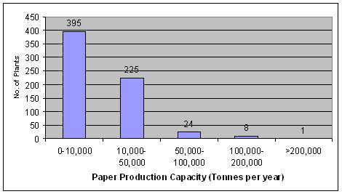
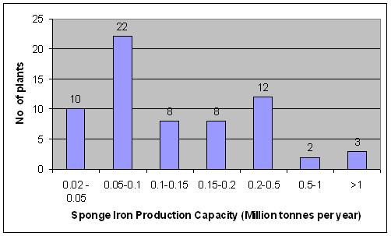
Diversity within Sectors in India - Capacity
Large variation in scale of production capacities

Slide 30
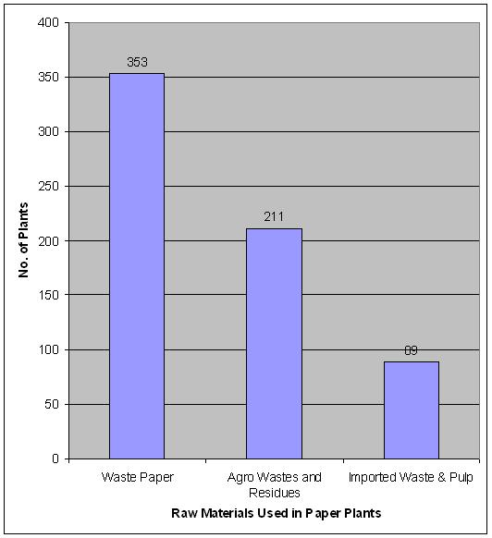
Diversity within Sectors in India – Raw Material Used

Slide 31
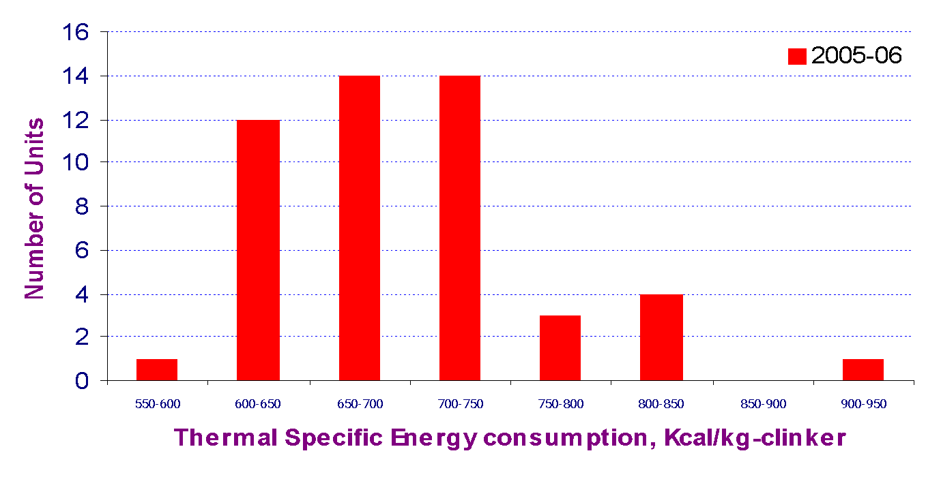
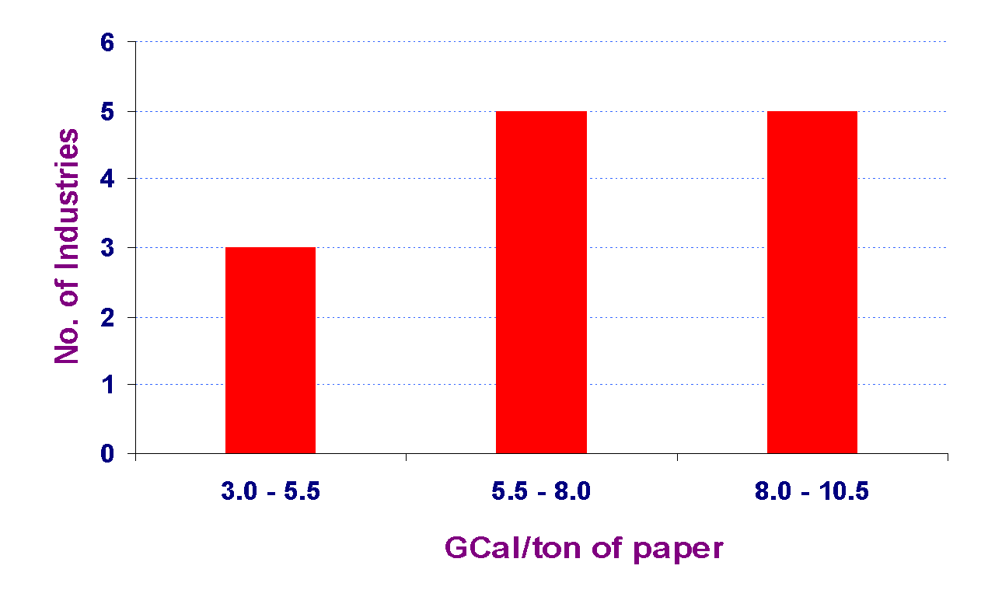
Diversity within Sectors in India – Specific Energy Consumption
Large bandwidth in specific energy consumption in all sectors
In almost every sector, the most energy-efficient unit is also amongst the most efficient units in the world

Slide 32
Creation of Energy Efficiency Services Ltd (EESL)
(a) Joint Venture between 4 Public Sector Companies under MOP- Main implementation arm of the National Mission for Enhanced Energy Efficiency – initial equity of USD 45 million.
(b) Lead in implementing energy efficiency projects as a ‘Super ESCO’
(c) Provide partial risk guarantee fund/ venture capital fund to ESCOs
(d) Leverage multilateral and bi-lateral financing
(e) Enter into partnerships, JVs with other implementing partners like ESCOs, industry, etc. to promote energy efficiency.
(f) Provide consultancy services to private and public sector in the areas of energy efficiency, CDM, etc.
(g) Take up revenue generating activities of BEE like implementing Standards and Labeling Programme, National Examination, etc.
‹#›
Notes:
‹#›

Slide 33
MOP=Ministry of Power
ESCOs = Energy Service Companies
CDM =Clean Development Mechanism
UNFCCC=united nations framework convection on climate change.
CERs= credit emission reduction
CAGR= compound annual growth rate
DSM=Demand Side Management Programme
CERC =Central Electricity Regulatory Commission
REC =Renewable Energy Certificate
‹#›

